Slide 1

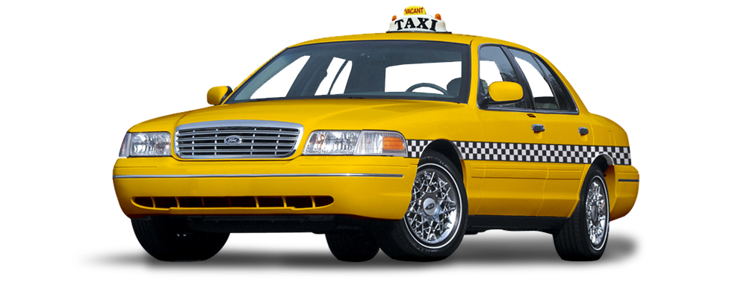
CAB BOOKING SYSTEM
(MINI PROJECT)
RAHUL YADAV (CSE –AIML) 2000331530040
PRATHAM SAXENA (CSE-AIML) 2000331530036
This Photo by Unknown Author is licensed under CC BY-NC

Slide 2
ABSTRACT
This Cab Booking App is a modern day tool to solve our day to day transportation related problems.
Cab booking app aims to provide relief to people facing these issues by providing easy to book, cheap and pleasant taxi rides to anyone with access to a smartphone.
The cab booking app is a two - way tool that encourages both the customers in need of a ride as well as taxi owners and cab service providers to register with the app, thus diminishing the distance between customers and taxi owners

Slide 3
MOTIVATION
My ride had a flat tire and I was stuck with no other option but a cab to get back home . I called Taxi-4- Less, the only popular cab service in town, Rakesh only to be on the phone call for about 10 minutes . I had trouble telling him where I was exactly located for pick up. Then, I had to keep calling the cab service, from time to time as they were already running late by 30 minutes which is frustrating
Passengers have no guarantee whether the cab would arrive on time or if it would arrive at all. After
reviewing a couple of websites, the idea of a Cab Reservation System dawned on me.
This application gives the user the facility to track the current status of the cab, thereby avoiding the frustration and long waits for the cabs.

Slide 4
INTRODUCTION
ToGo Cabs is an Cab Reservation application.
The main objective of the project is to provide an easy to use application to the android users which enables them to reserve a cab from one location to any location .
The application generated Confirmation Number makes the application more reliable.
The users can keep track of their reservations, the amount they have spent for each ride and the cab's current status.

Slide 5
OBJECTIVE
Online Cab Booking System is a web based platform the allows your customers to book their taxi's online from comfort of their own home or office.
The platform should offer a ministration interface where the taxi company can manage the customer, and access all bookings and Per information.
More and more Taxi companies are looking for integrated tax booking systems as it makes life much easier for the traveller- this is highly important and in today's internet age people should be able to book taxi’s online without having to pick up the phone and the taxi company as all their bookings are now manged via app and system which means they have an electrine, valid fare and historic bookings.

Slide 6
FEASIBILITY STUDY
ECONOMIC FEASIBILIT
TECHNICAL FEASIBILITY
To develop this application, an internet connection and a database server is required.
BEHAVIOURAL FEASIBILITY
This application requires no
user guidance or manual as
The application is economically feasible as it only requires a system the application of cab booking system.
However, users should be able to connect to the internet either through cellular or Wi-Fi and should able to receive messages. This would be the only cost incurred on the project.
it is easy to use and understand and also has a user friendly interface.
The application works in accordance with the design.
The application was
deployed and tested on a device, thereby making it
technically feasible.

Slide 7
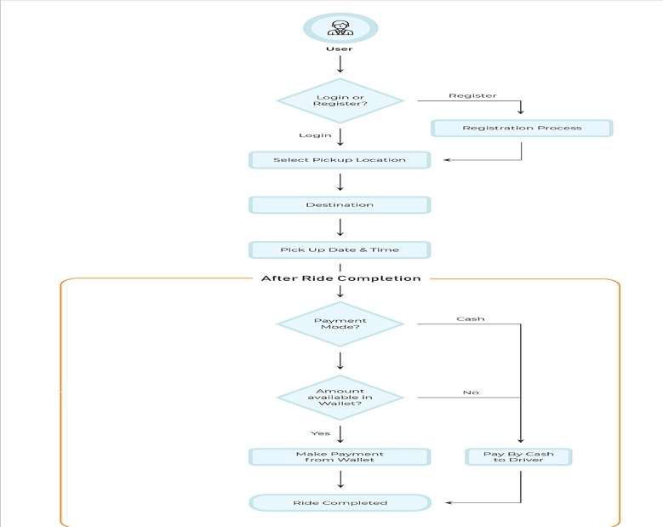
FLOWCHART

Slide 8
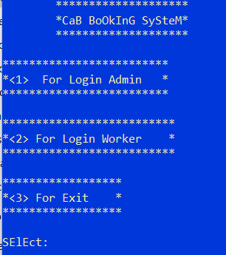
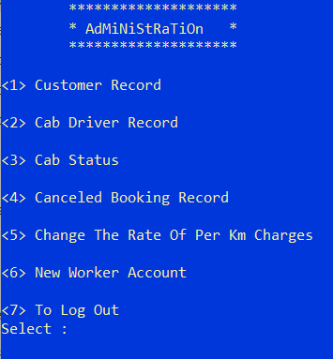
OUTPUT

Slide 9
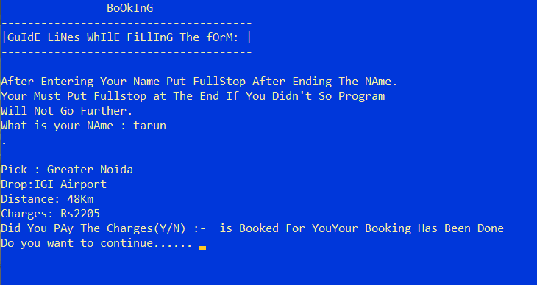

Slide 10
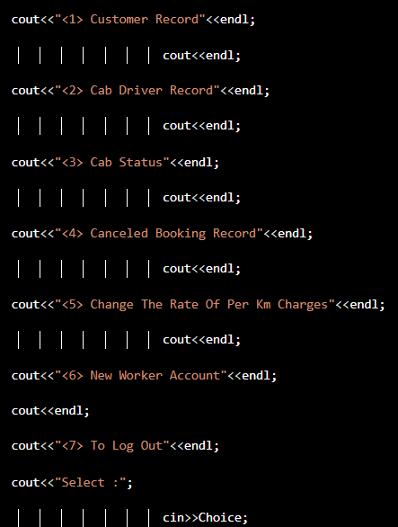
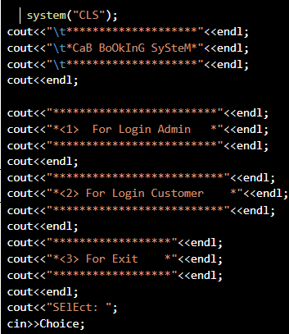
MODULES

Slide 11
SCOPE OF THE STUDY
The present study covers factors like innovativeness, price consciousness, and coupon redemption behaviour.
There may be other factors influencing the consumers in selection of cab services which are not covered in the study.
This study had not covered the influence of demographic characteristics on other psychographic
variables.

Slide 12
SOFTWARE/HARDWARE REQUIREMENTS
Compatible Software Requirements:
Windows, Windows XP or above
Linux
Ubuntu
MacOS 10.12 or above.
Minimum Hardware Requirements:
Hard disk: 40 GB.
RAM: 2 GB.
Processor: Pentium(R)Dual-core CPU

Slide 13
BIBLIOGRAPHY
•
•
•
•
https://www.geeksforgeeks.org / https://www.tutorialpoint.com/index.htm https://w3schools.com/
https://jstor.org/

Slide 14
THANK YOU

